Slide 1
Chapter 6
Array-Based Lists

Slide 2
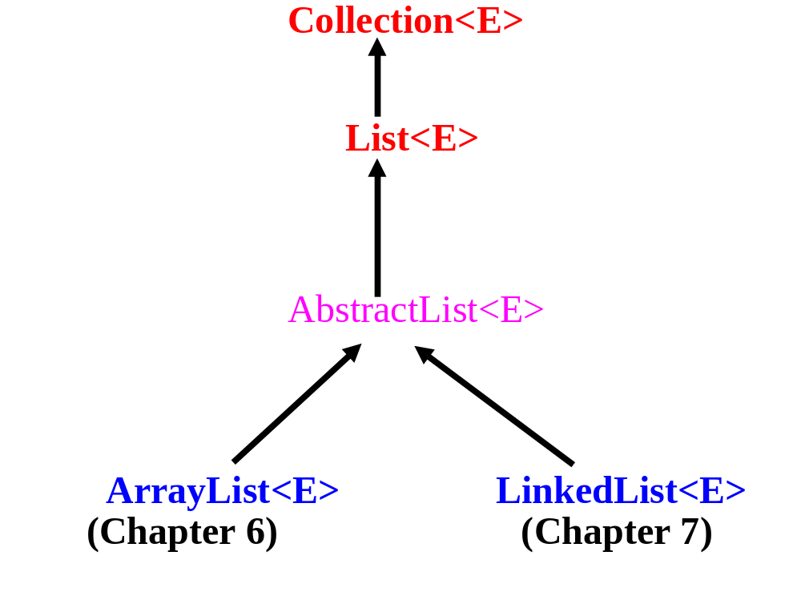

Slide 3
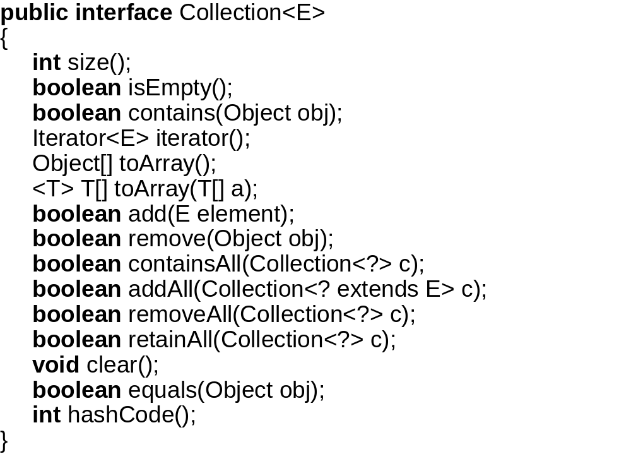

Slide 4


Slide 5
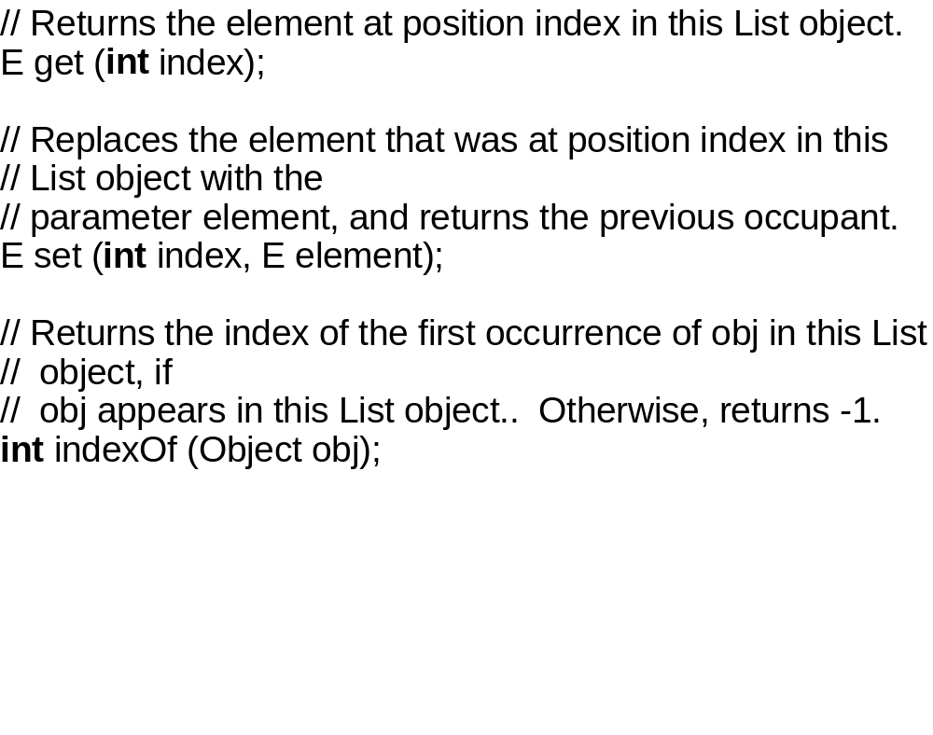

Slide 6
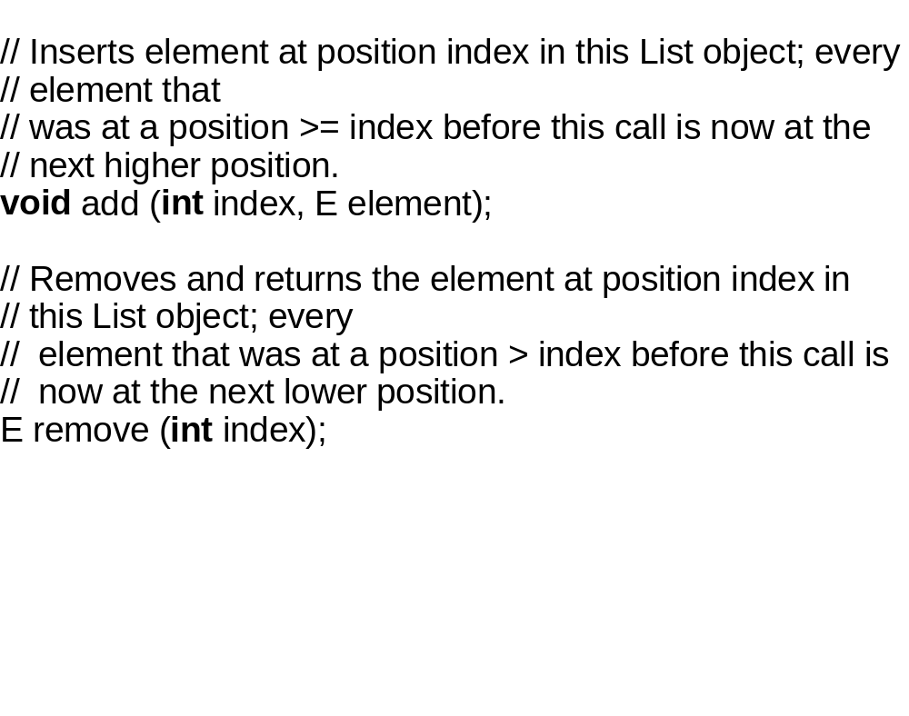

Slide 7
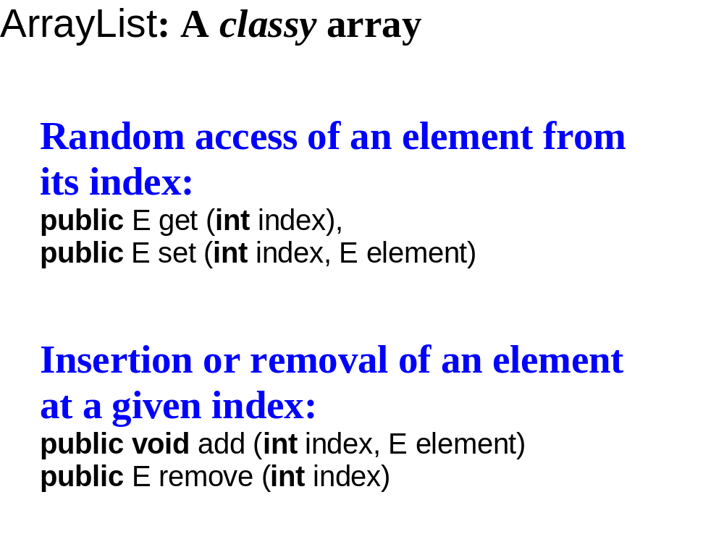

Slide 8


Slide 10
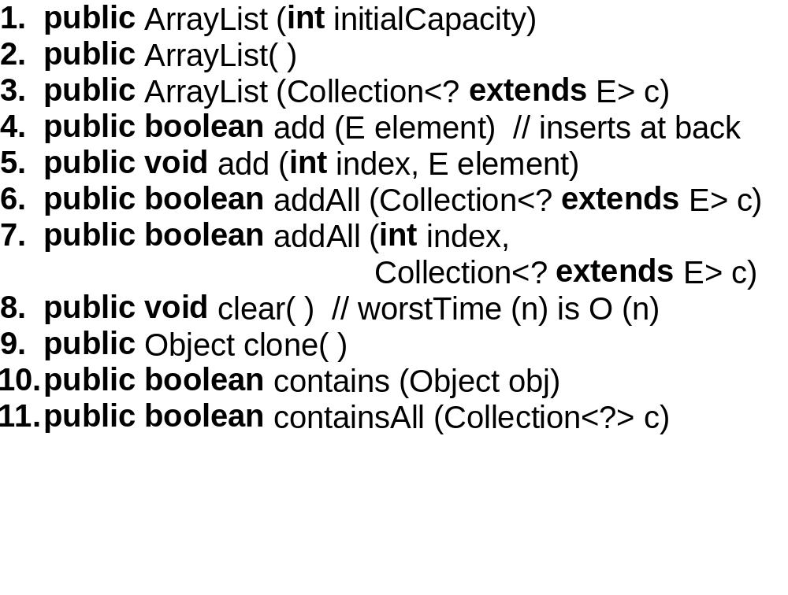

Slide 11
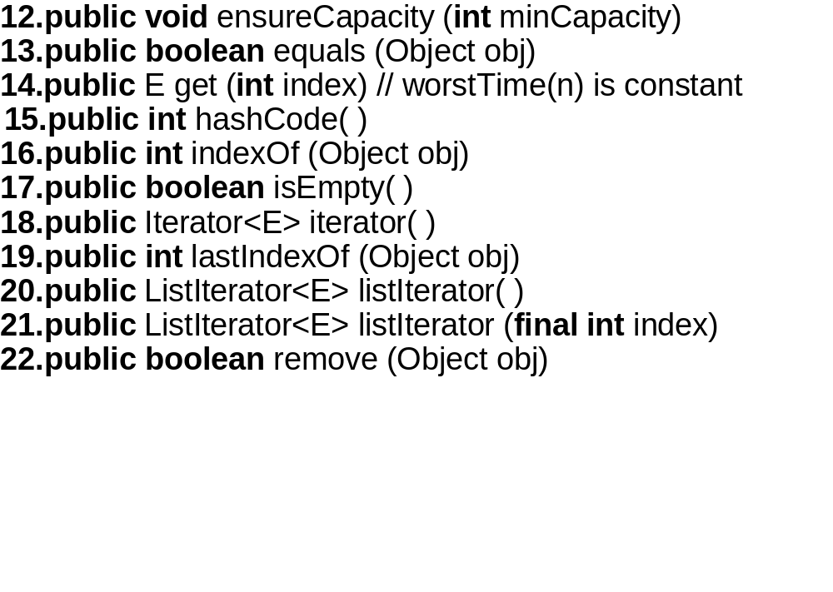

Slide 12
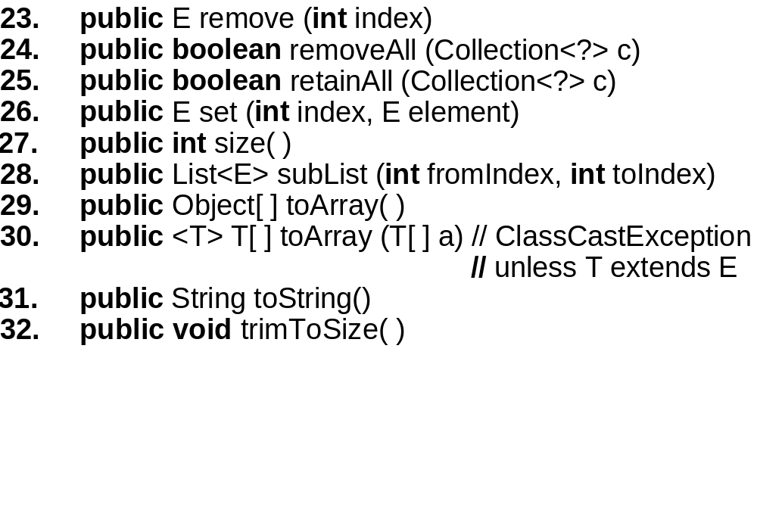

Slide 13
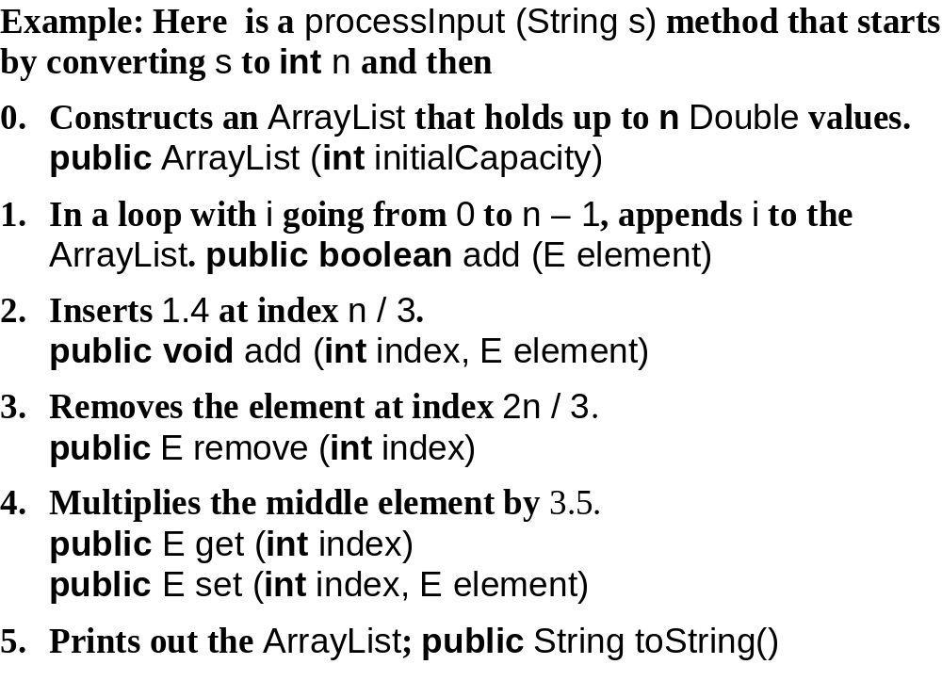

Slide 14
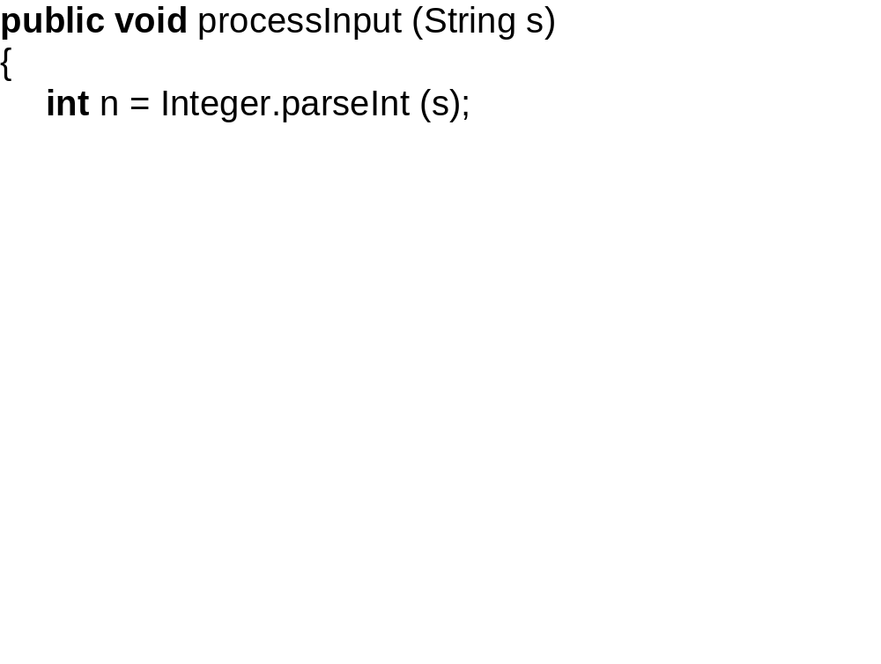

Slide 15
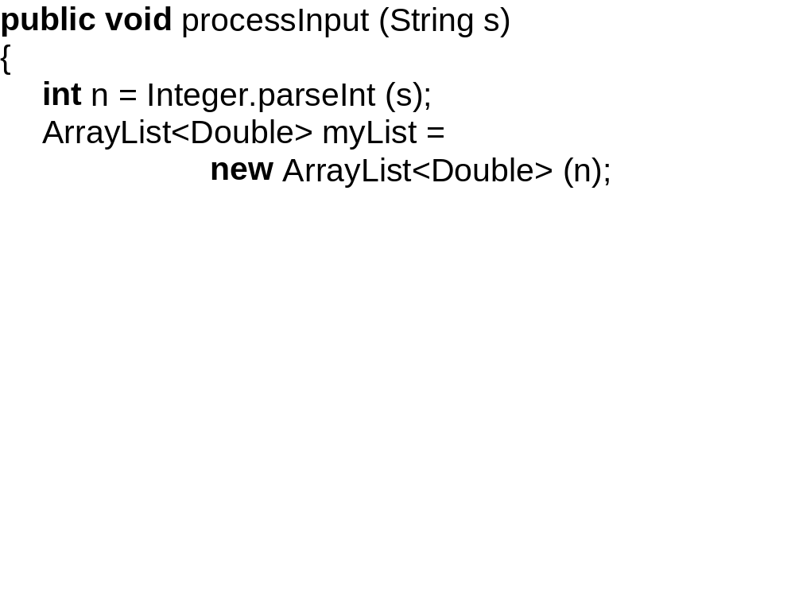

Slide 16
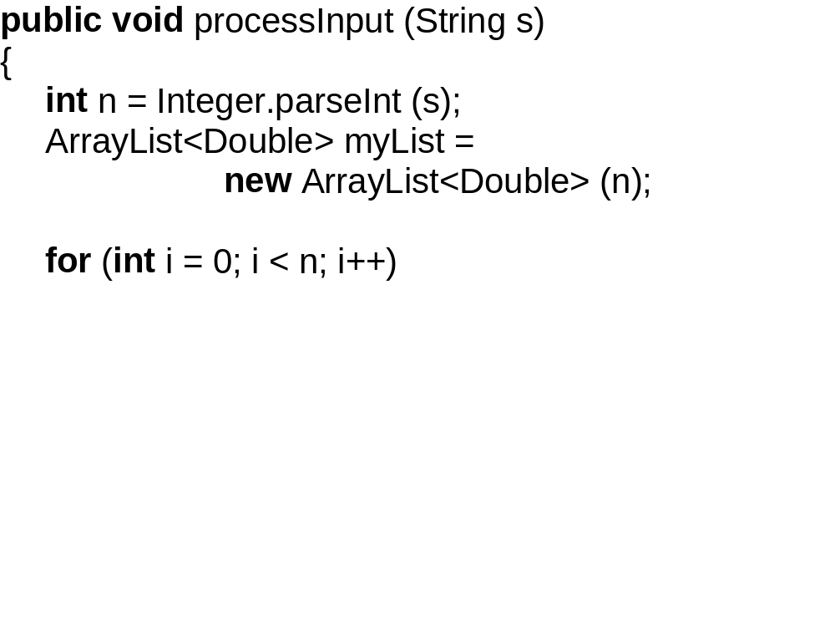

Slide 17
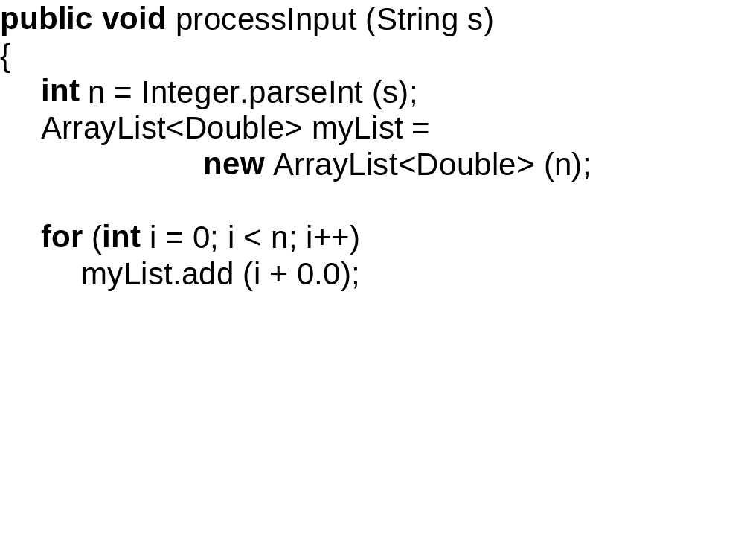

Slide 18
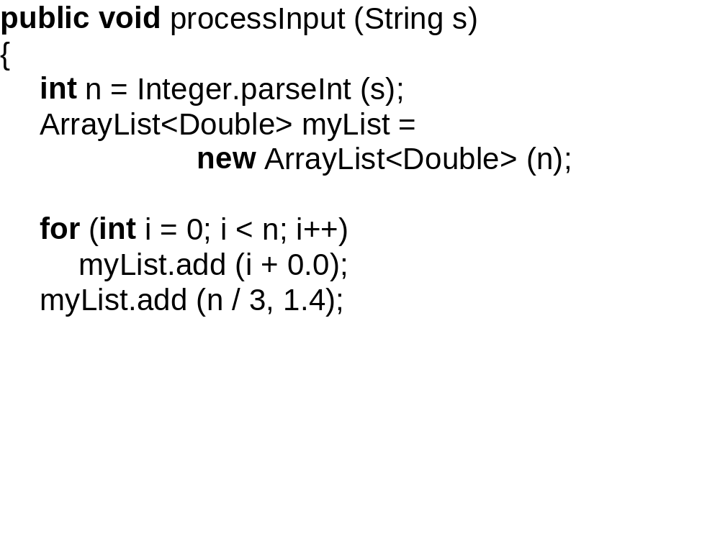

Slide 19
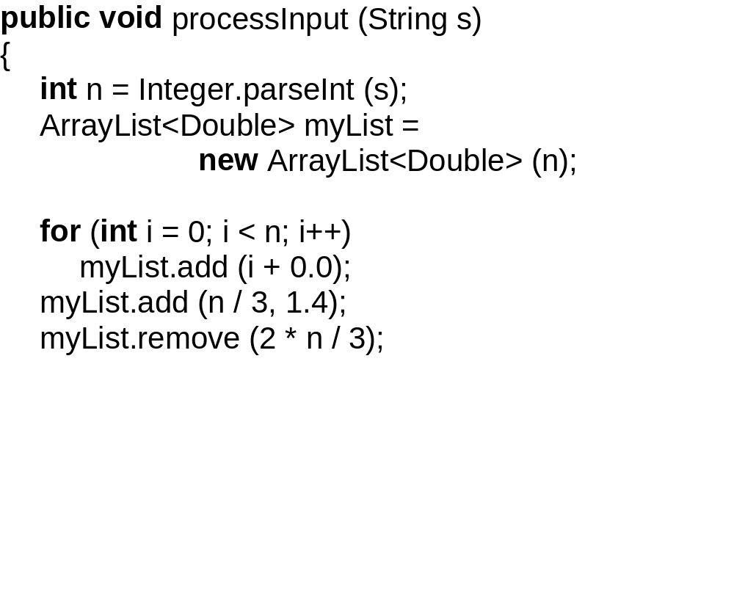

Slide 20
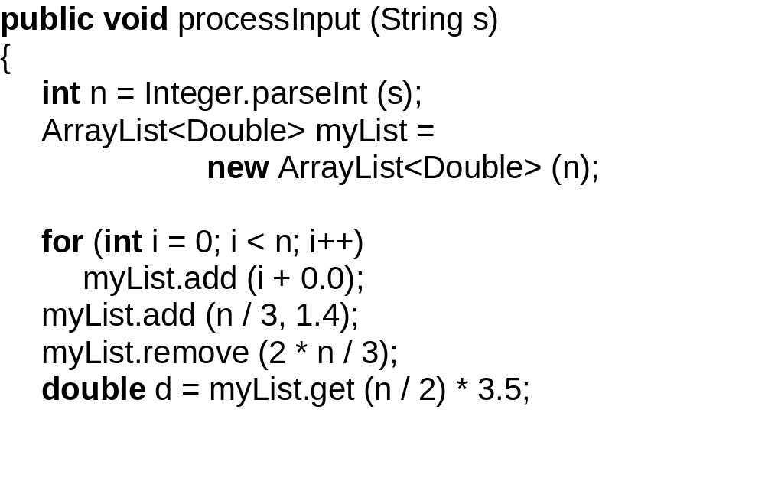

Slide 21
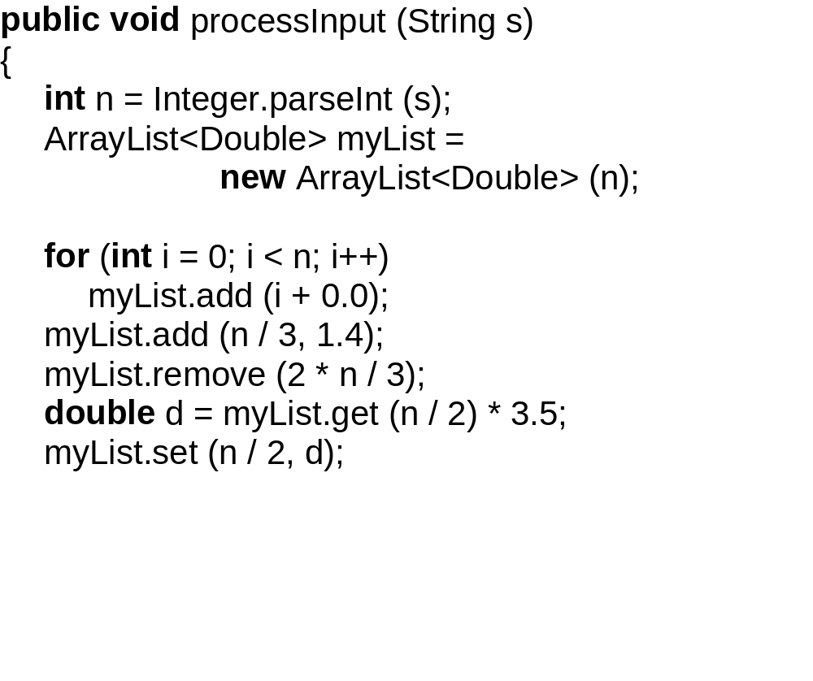

Slide 22
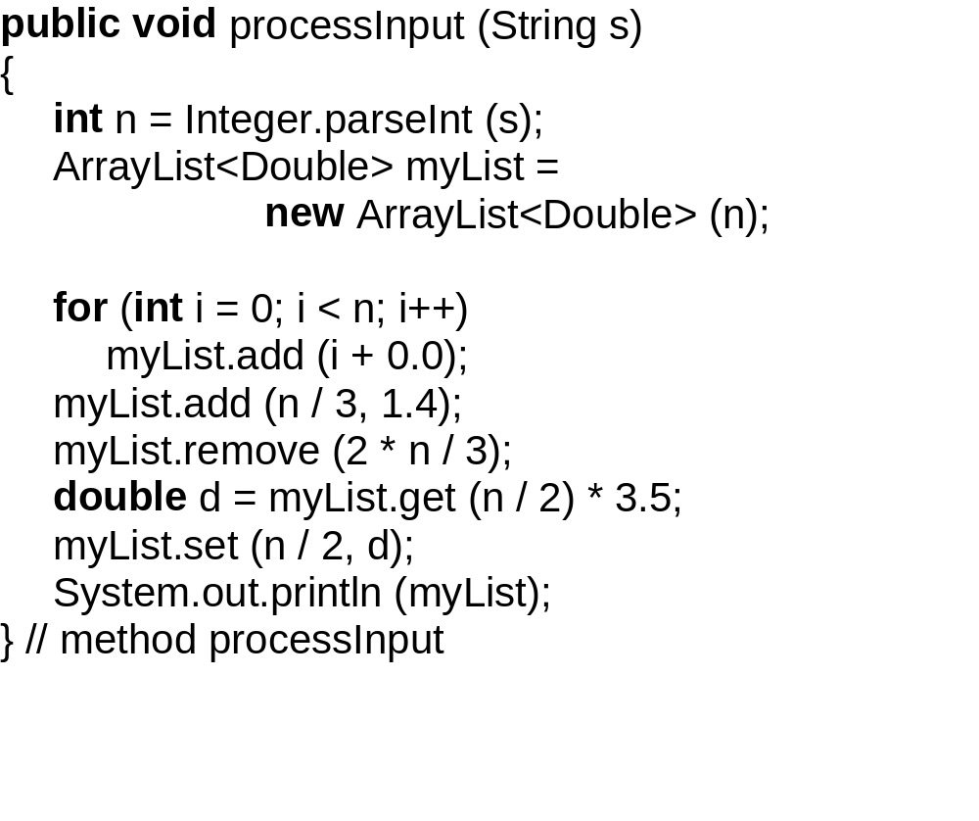

Slide 23
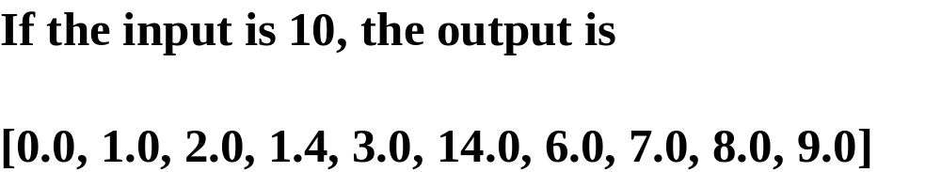

Slide 24
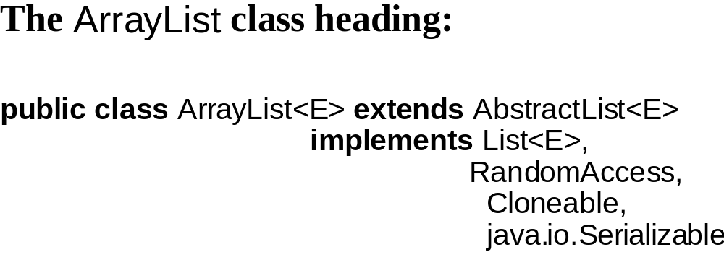

Slide 25
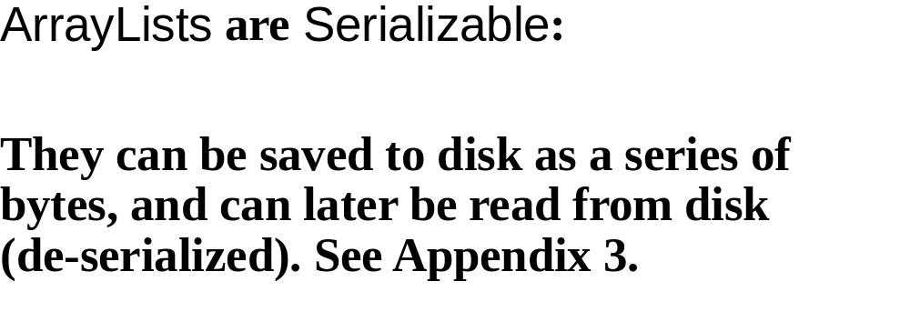

Slide 26
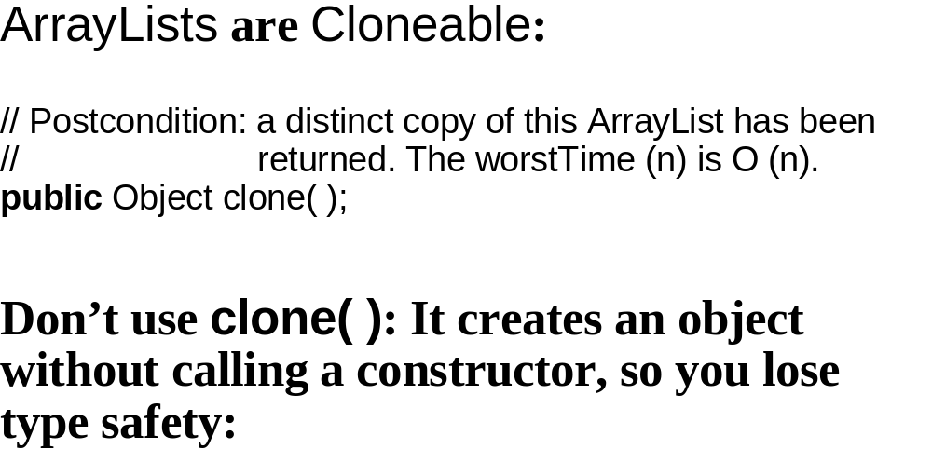

Slide 27
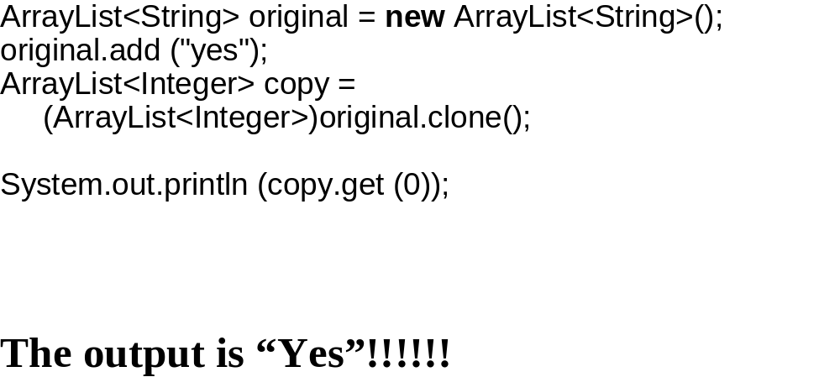

Slide 28
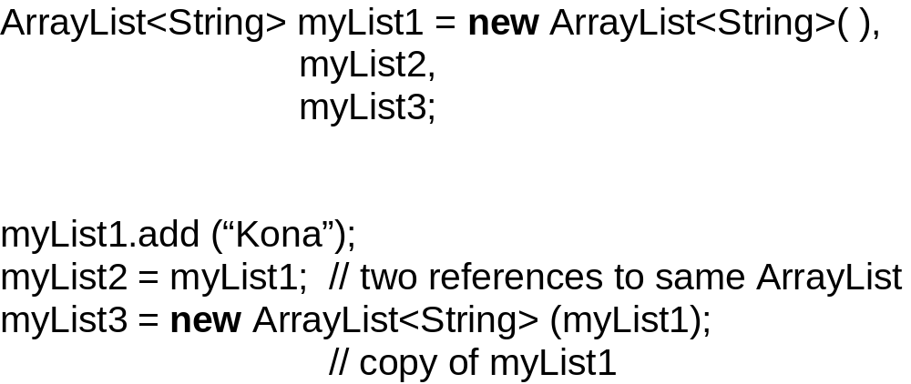

Slide 29
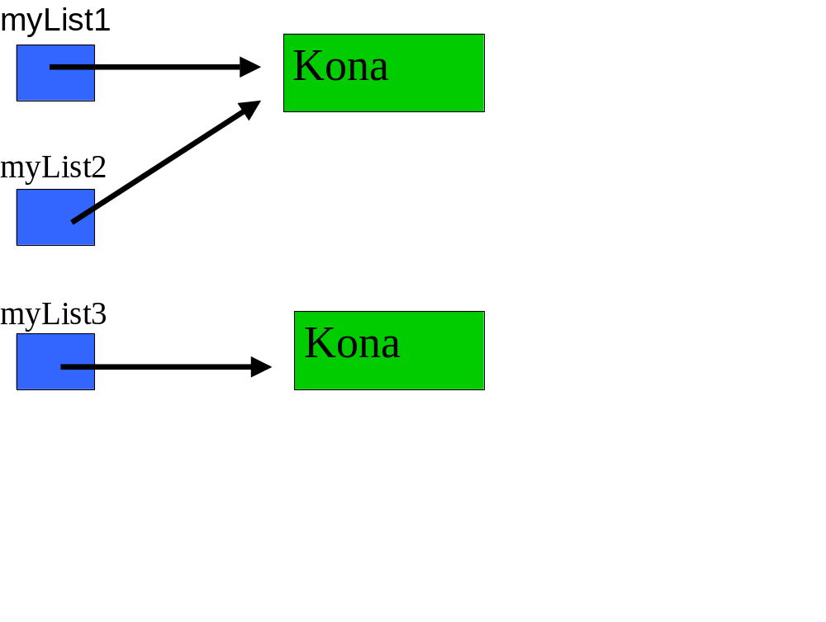

Slide 30
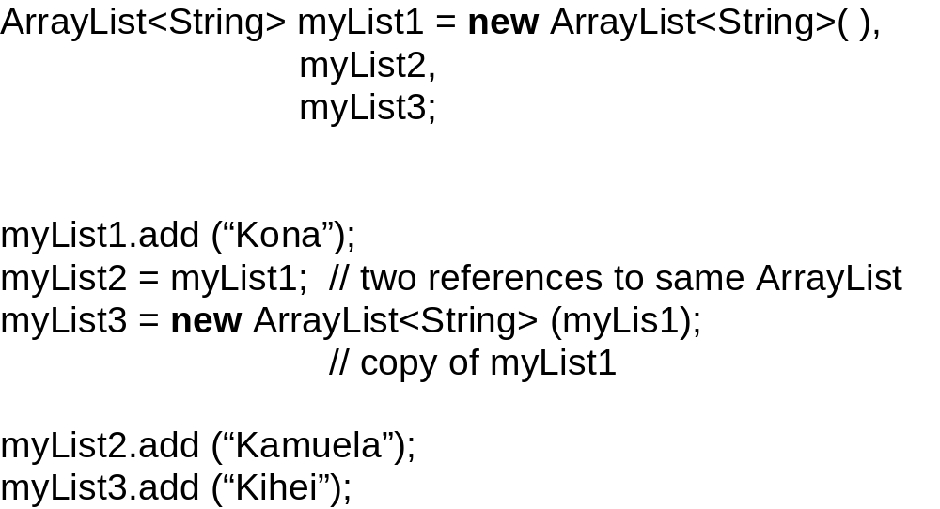

Slide 31
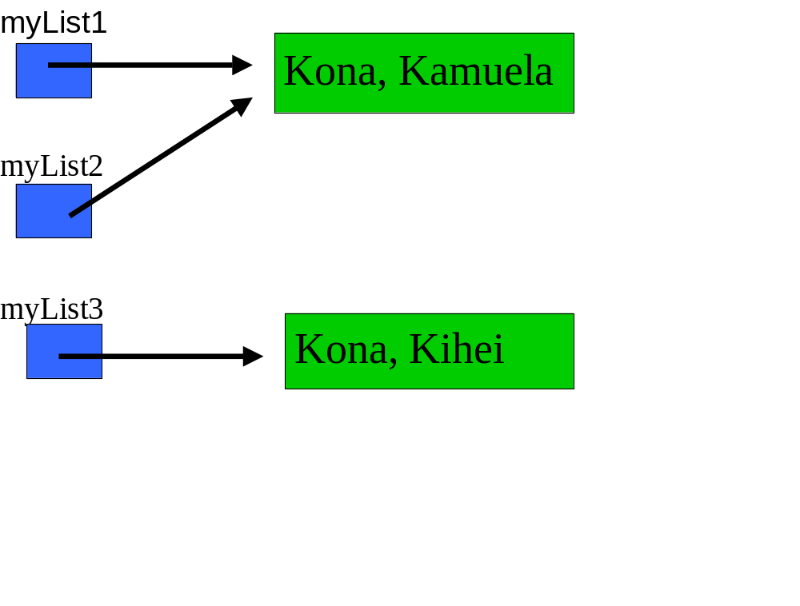

Slide 32
Fields in the ArrayList class
private transient E[ ] elementData;
// “transient” means that the array elementData
need // not be saved if the ArrayList object is
serialized. The // individual elements will be saved,
but not the array.
private int size;

Slide 33
// Initializes this ArrayList object to be empty
and with a // capacity given by initialCapacity.
public ArrayList (int initialCapacity)
{
elementData = (E[ ]) new Object [initialCapacity];
} // constructor with int parameter

Slide 34
// Initializes this ArrayList object to be empty.
public ArrayList ( )
{
this (10);
}

Slide 35
// Appends element to this ArrayList object and
// returns true. The averageTime(n) is constant
and // worstTime(n) is O (n).
public boolean add (E element)
{
ensureCapacity (size + 1);
elementData [size++] = element;
return true;
}

Slide 36
public void ensureCapacity(int minCapacity) {
int oldCapacity = elementData.length;
if (minCapacity > oldCapacity) {
// Increase the capacity by at least 50%,
// and copy the old array to the new array.
}
}

Slide 37
public void ensureCapacity(int minCapacity) {
modCount++; // See Appendix 2
int oldCapacity = elementData.length;
if (minCapacity > oldCapacity) {
E oldData[] = elementData;
int newCapacity = (oldCapacity * 3) / 2 + 1;
if (newCapacity < minCapacity)
newCapacity = minCapacity;
elementData = (E[ ]) new Object[newCapacity];
System.arraycopy(oldData, 0, elementData, 0,
size);
}
}

Slide 38
// Initializes this ArrayList to a copy of c.
public ArrayList(Collection<? extends E> c)
{
size = c.size();
// Allow 10% room for growth
elementData =
(E[])new Object[(int)Math.min(
(size*110L)/100,Integer.MAX_VALUE)];
c.toArray(elementData);
}
Note: This is called the copy constructor.

Slide 39


Slide 40
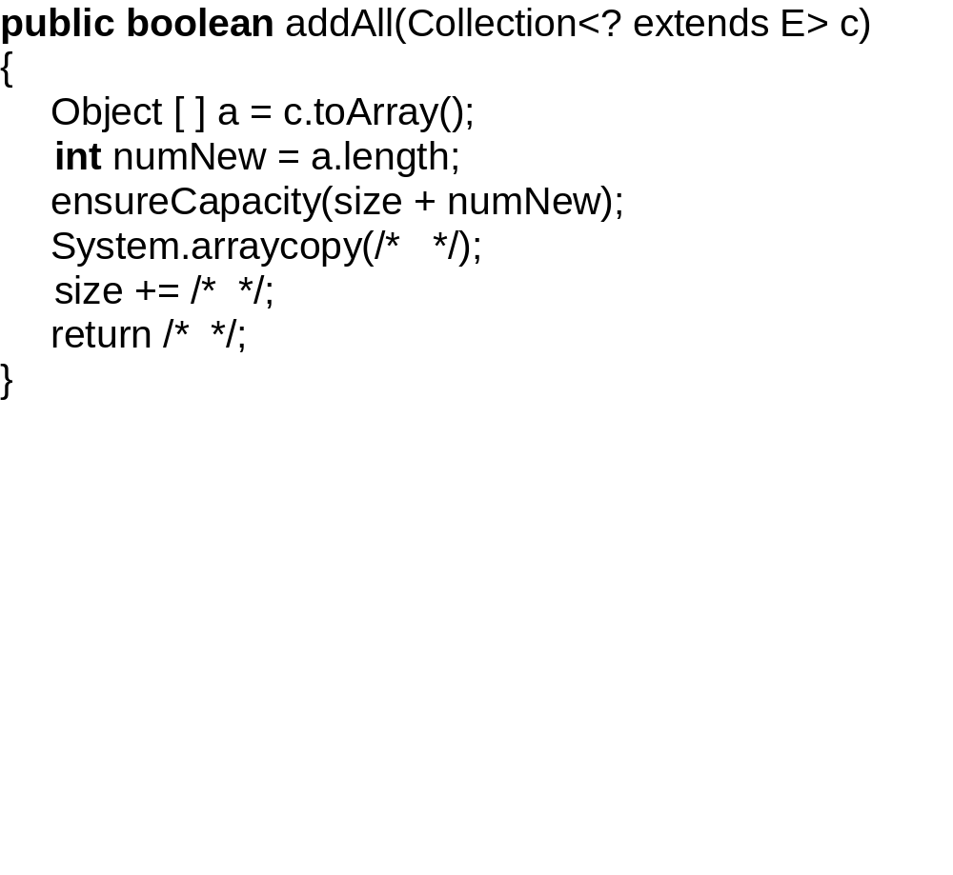

Slide 41
Iterators – not needed for ArrayListS
for (int j = 0; j < myList.size( ); j++)
System.out.println (myList.get (j));

Slide 42
But iterators are legal:
Iterator<Double> itr = myList.iterator( );
while (itr.hasNext( ))
System.out.println (itr.next( ));

Slide 43
Even better:
for (Double d : myList)
System.out.println (d);

Slide 44
Application
High-Precision Arithmetic

Slide 45
In public-key cryptography, the integers
are hundreds of digits long.

Slide 46
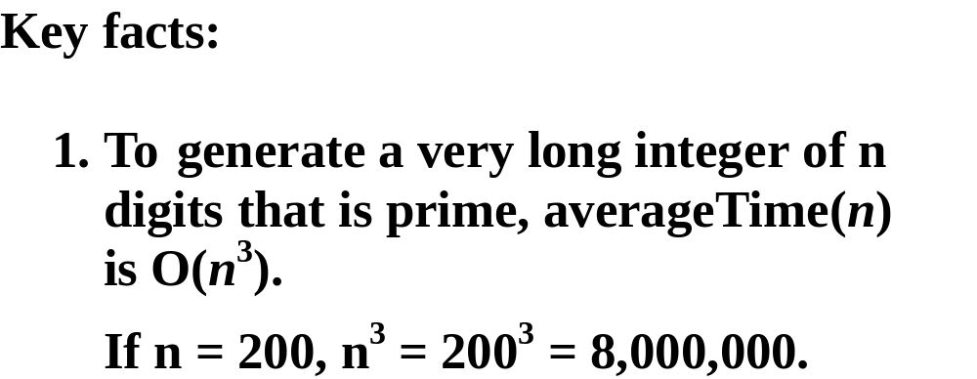

Slide 47
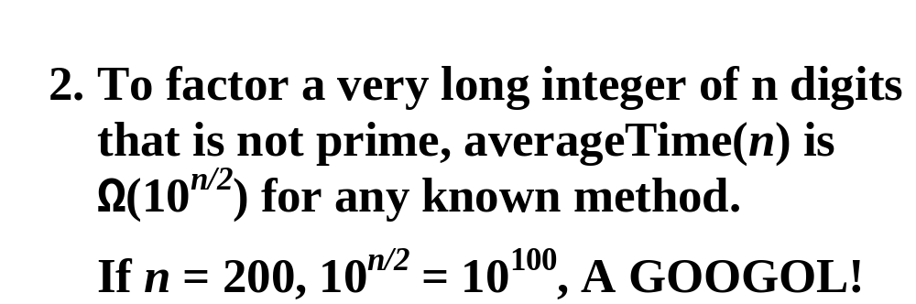

Slide 48
3. Given primes p and q, pq is used
to encode a public message.

Slide 49
4. To decode the message, p and q
must be known.

Slide 50
We will now develop a VeryLongInt class
to handle very long integers.
In the method descriptions, n refers to
the number of digits in the calling object.

Slide 51
/** Initializes this VeryLongInt object from a given String
* object. The worstTime(n) is O(n), where n represents
* the number of characters in s.
*
* @param s – the given String object.
*
* @throws NullPointerException – if s is null.
*
*/
public VeryLongInt (String s)

Slide 52
/**
* Returns a String representation of this VeryLongInt
* object. The worstTime(n) is O(n), where n represents
* the number of digits in this VeryLongInt object.
*
* @return a String representation of this VeryLongInt
* object: [highest digit, next highest digit, …].
*
*/
public String toString()

Slide 53
/**
* Increments this VeryLongInt object by a specified
* VeryLongInt object.
* The worstTime(n) is O(n), where n is the number of
* digits in the larger of this VeryLongInt object (before the
* call) and the specified VeryLongInt object.
*
* @param otherVeryLong – the specified VeryLongInt
* object to be added to this VeryLongInt object.
*
* @throws NullPointerException – if otherVeryLong is
* null
*
*/
public void add (VeryLongInt otherVeryLong)

Slide 54
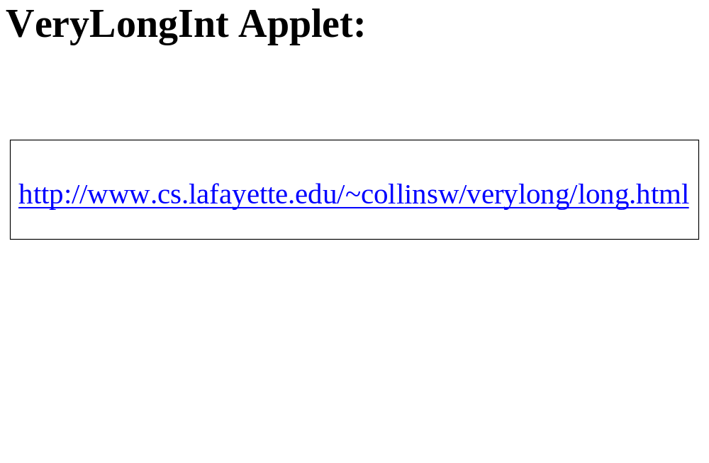

Slide 55
For example, the following code constructs two VeryLongInt objects with values 345
and 6789 and prints out their sum.

Slide 56
VeryLongInt very1 = new VeryLongInt (“345”);
VeryLongInt very2 = new VeryLongInt (“6789”);
very1.add (very2);
System.out.println (very1); // = System.out.println
// (very1.toString( ));

Slide 57
Fields and method definitions for the VeryLongInt class
The only field is:
protected ArrayList<Integer> digits; // holds all of the
// digits in this VeryLongInt

Slide 58
public VeryLongInt (String s)
{
final char LOWEST_DIGIT_CHAR = '0';
digits = new ArrayList<Integer> (s.length());
for (int i = 0; i < s.length(); i++)
{
char c = s.charAt (i);
if (Character.isDigit(c))
digits.add (c – LOWEST_DIGIT_CHAR);
} // for
} // constructor with string parameter

Slide 59
public String toString( )
{
return digits.toString();
} // method toString

Slide 60
For the add method:
VeryLongInt a1,
a2;
// a1 = {3, 8, 7, 4, 9, 8}
// a2 = {5, 3, 6, 4}
a1.add (a2);

Slide 61
Loop 6 times:
0: 8 + 4 = 12
Append 2, and the carry is 1.
1: 9 + 6 + 1 (the carry) = 16
Append 6 and the carry is 1.
...
We end up with 268293, so reverse.

Slide 62
public void add (VeryLongInt otherVeryLong) {
final int BASE = 10;
int largerSize,
partialSum,
carry = 0;
if (digits.size() > otherVeryLong.digits.size())
largerSize = digits.size();
else
largerSize = otherVeryLong.digits.size();
ArrayList<Integer>sumDigits =
new ArrayList<Integer>(largerSize + 1);

Slide 63
for (int i = 0; i < largerSize; i++) {
// Add the ith least significant digit in the
// calling object, the ith least significant digit
// in otherVeryLong, and the carry.
// Append that sum % 10 to sumDigits
// The new carry is that sum / 10.
} // for
if (carry == 1)
sumDigits.add (carry);
Collections.reverse (sumDigits);
digits = sumDigits;
} // method add

Slide 64
for (int i = 0; i < largerSize; i++)
{
partialSum = least (i) +
otherVeryLong.least (i) + carry;
carry = partialSum / BASE;
sumDigits.add (partialSum % BASE);
} // for
if (carry == 1)
sumDigits.add (carry);
Collections.reverse (sumDigits);
digits = sumDigits;
} // method add

Slide 65
Suppose the VeryLongInt object has the value 13579. Then
least (0) returns 9
least (1) returns 7
least (2) returns 5
least (3) returns 3
least (4) returns 1
least (5) returns 0

Slide 66
/** Returns the ith least significant digit in digits if i is a non-
* negative int less than digits.size(). Otherwise, returns 0.
*
* @param i – the number of positions from the right-most digit in
* digits to the digit sought.
*
* @return ith least significant digit in digits, or 0 if no such digit.
*
* @throws IndexOutOfBoundsException – if i is negative.
*
*/
protected int least (int i)
{
if (i >= digits.size())
return 0;
return digits.get (digits.size() - i - 1);
} // least

Slide 67
How long does the add method take, on average? Recall that n refers to the number
of digits.

Slide 68
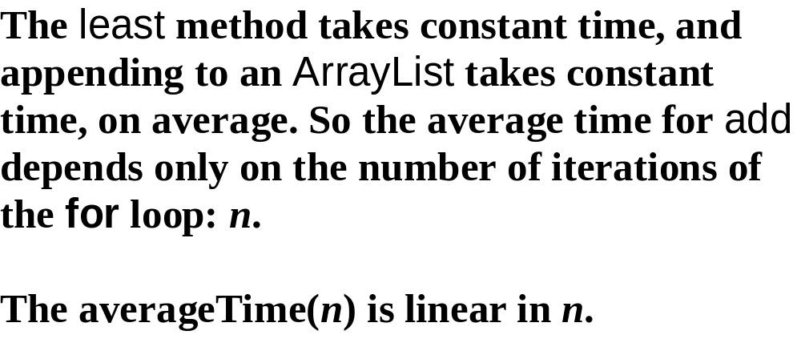

Slide 69
Exercise: In the VeryLongInt class, define the size() method:
// Returns the number of digits in this VeryLongInt
// object.
public int size( )

